Slide 1
MEC-107: Basic Engineering Mechanics

Slide 2

Text Books & References
Text Books
Ferdinand P . Beer, E. Russell Johnston (2007), “Vector Mechanics for Engineers: Statics and Dynamics”, McGraw-Hill InternationalEdition.
2. J. L. Meriam and L. G. Kraige (2006), “Engineering Mechanics: Staticsand Dynamics (6th Edition)”,Wiley Publishers
Reference
1. Irving H. Shames, (2003), “Engineering Mechanics – Statics and Dynamics”, Prentice-Hallof India Private limited.
2. Russell C Hibbeler, (2009), “Engineering Mechanics: Statics and Dynamics (12thEdition)”,Prentice Hall.
3. Anthony M. Bedford and Wallace Fowler (2007), “Engineering Mechanics: Statics and Dynamics (5th Edition)”,Prentice Hall.

Slide 3
Module 1
Module | Description of Topic | Lecture Hours
1 | Fundamental Principles - Coplanar forces - Resolution and Composition of forces and equilibrium of particles - Forces of a particle in space - Equivalent system of forces - Principle of transmissibility - Single equivalent force - Free body diagram - Equilibrium of rigid bodies in two dimensions and three dimension | 6

Slide 4
WHAT IS MECHANICS?
Mechanics can be defined as that science which describes and predicts the conditions of rest or motion of bodies under the action of forces.
It is divided into three parts:
Mechanics of rigid bodies,
Mechanics of deformable bodies, and
Mechanics of fluids.

Slide 5
Mechanics
The mechanics of rigid bodies is subdivided into
Statics and
Dynamics
Mechanics
Rigid bodies
Statics
Dynamics
Deformable bodies
Fluids
Kinetics
Kinematics
Compressible
In-Compressible

Slide 6
Rigid Body Mechanics
Statics: deals with equilibrium of bodies under action of forces (bodies may be either at rest or move with a constant velocity).
Dynamics: deals with motion of bodies (accelerated motion).
Rigid bodies
Statics
Dynamics
Kinematics
Kinetics
Displacement
Velocity
Acceleration
Force/Torque
Energy/momentum

Slide 7
Force
Force represents the action of one body on another.
It changes (or) tends to change the state of rest or uniform motion of a body
A force is characterized by its point of application, magnitude, and direction, i.e., a force is a vector. (Free vector, Sliding Vector, Fixed Vector)

Slide 8
Particle & Rigid body
Particle - a very small amount of matter which may be assumed to occupy a single point in space.
Rigid body - a combination of a large number of particles occupying fixed positions with respect to each other.

Slide 9
SIX FUNDAMENTAL PRINCIPLES
The Parallelogram Law for the Addition of Forces.
The Principle of Transmissibility
Newton’s First Law of motion
Newton’s Second Law of motion
Newton’s Third Law of motion
Newton’s Law of Gravitation

Slide 10
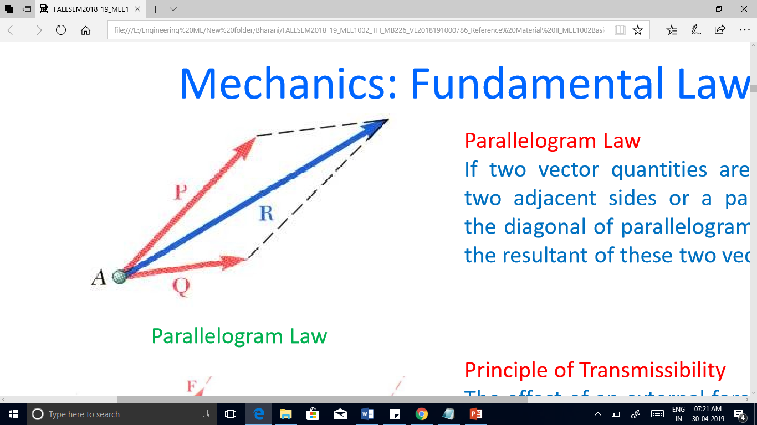
Parallelogram Law for the Addition of Forces
Two forces acting on a particle may be replaced by a single force, called their resultant.
It is obtained by drawing the diagonal of the parallelogram which has sides equal to the given forces.

Slide 11
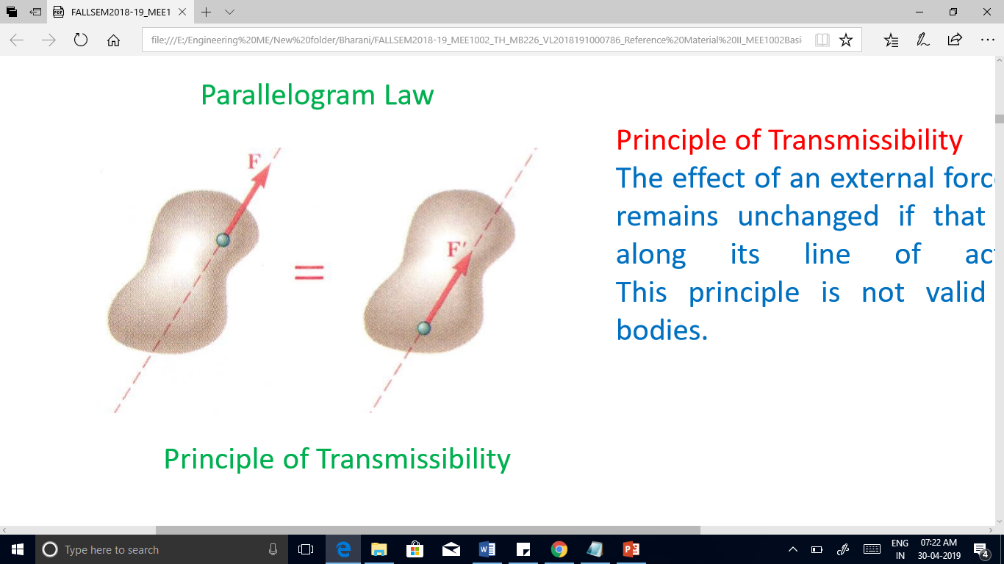
Principle of Transmissibility
The conditions of equilibrium or of motion of a rigid body will remain unchanged if a force acting at a given point of the rigid body is replaced by a force of the same magnitude and same direction, but acting at a different point, provided that the two forces have the same line of action.

Slide 12
FIRST LAW
The resultant force acting on a particle is zero, the particle will remain at rest (if originally at rest) or will move with constant speed in a straight line (if originally in motion).

Slide 13
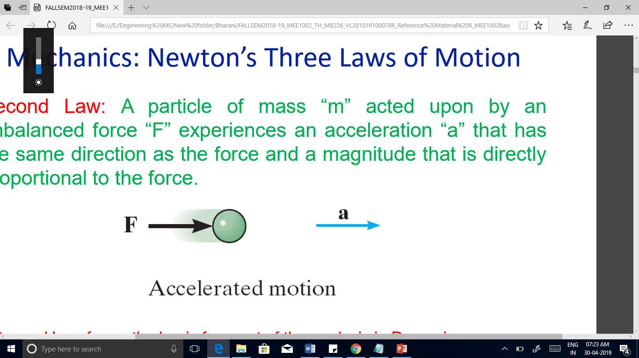
SECOND LAW
The particle will have an acceleration proportional to the magnitude of the resultant force and acceleration takes place in the direction of this resultant force. Also, acceleration is inversely proportional to mass of an object.

Slide 14
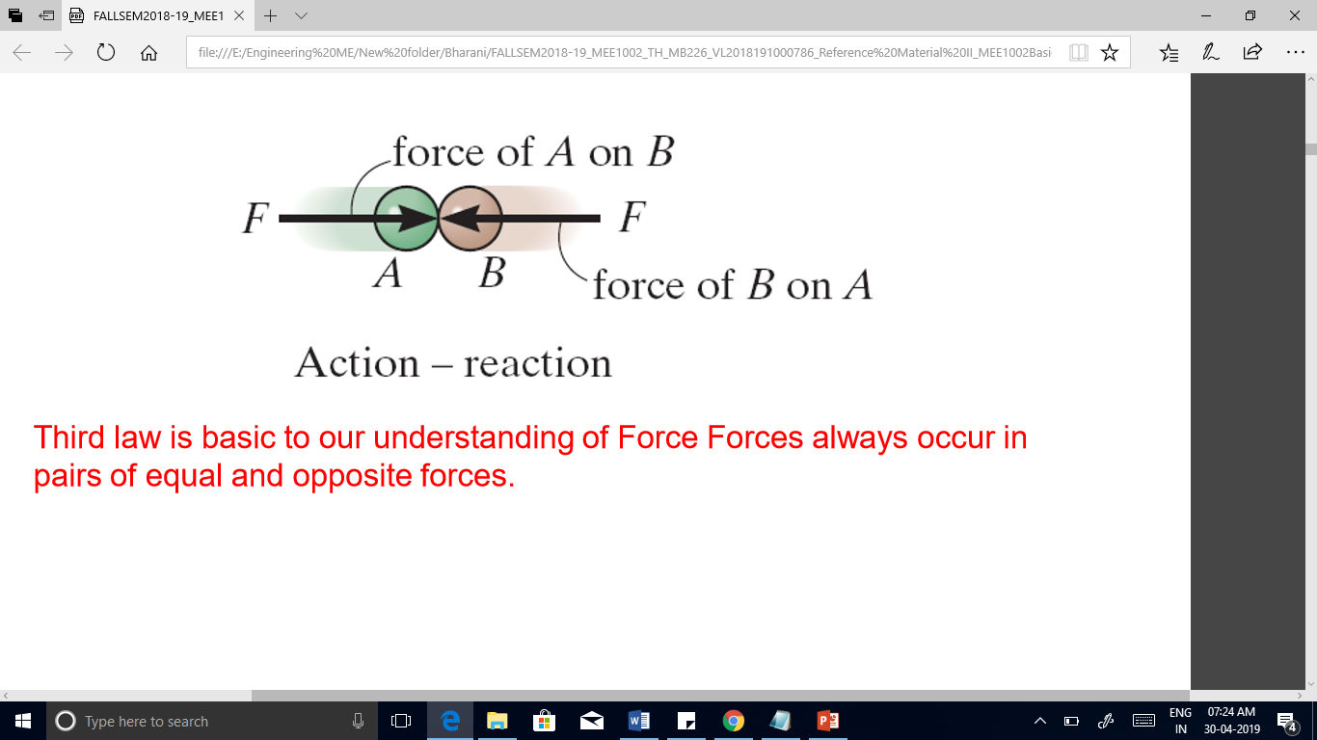
THIRD LAW
The forces of action and reaction between bodies in contact have the same magnitude, same line of action, and opposite sense

Slide 15
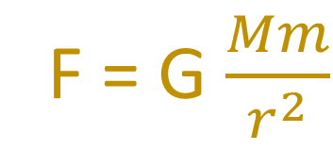
Newton’s Law of Gravitation
Two particles of mass M and m are mutually attracted with equal and opposite forces F and -F of magnitude F given by the formula

Slide 16
Method of Problem Solution
• Problem Statement:
Includes given data, specification of what is to be determined, and a figure showing all quantities involved.
• Free-Body Diagrams
Create separate diagrams for each of the bodies involved with a clear indication of all forces acting on each body.
• Fundamental Principles
The six fundamental principles are applied to express the conditions of rest or motion of each body. The rules of algebra are applied to solve the equations for the unknown quantities.

Slide 17
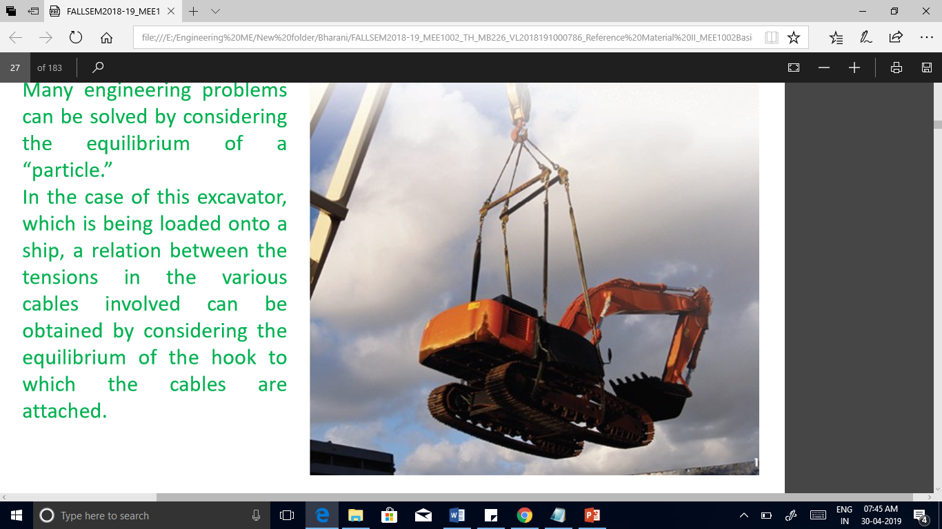
Statics of Particles

Slide 18
Statics of Particles
Particle: Size and shape of the body are neglected, but not the mass.
Forces in a plane
Resultant of several concurrent forces (Polygon law)
Resolution of a force into components
Rectangular components of a force : Unit vectors
Addition of forces by summing X and Y components
Equilibrium of a Particle

Slide 19
Forces in a plane
A force represents the action of one body on another and is generally characterized by
its point of application,
its magnitude, and
its direction
Unit: Newton (N)
1 Newton is defined as the force which gives an acceleration of 1 m/s² to a mass of 1 kg.

Slide 20
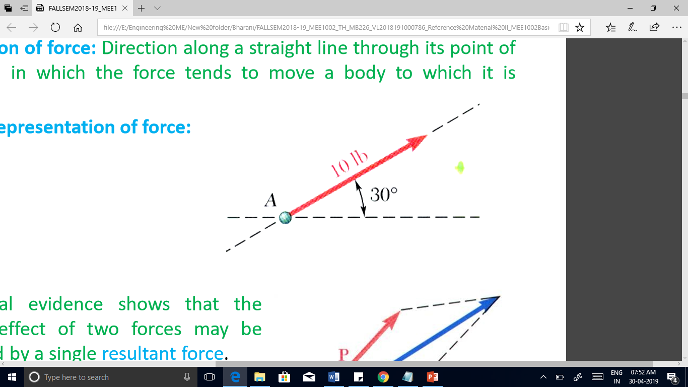
Forces
Concentrated force or a point force: it is the force acting on a very small area.
Distributed force: force distributed over a length or an area or a volume.
Line of action of force: Direction along a straight line through its point of application, in which the force tends to move a body to which it is applied.
Graphical representation of force

Slide 21
System of forces
When several forces of various magnitude and direction act upon a body they are said to form system of forces.
Classification of system of forces: Classified as per orientation of line of action of forces.
Concurrent force system: acts on a particle or rigid body
Parallel and General force system: acts mainly on rigid bodies

Slide 22
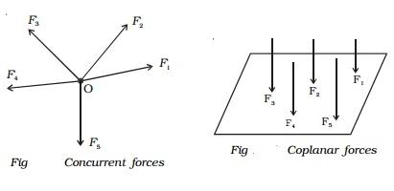
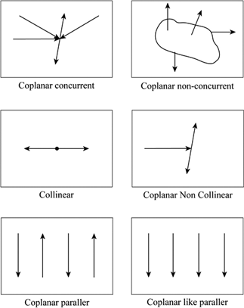
System of forces
System of Forces
Coplanar (in Plane/ 2-D)
Concurrent
Non-Concurrent
Non-Coplanar (Space/ 3-D)
Concurrent
Non-Concurrent
Parallel
General
Parallel
General

Slide 23
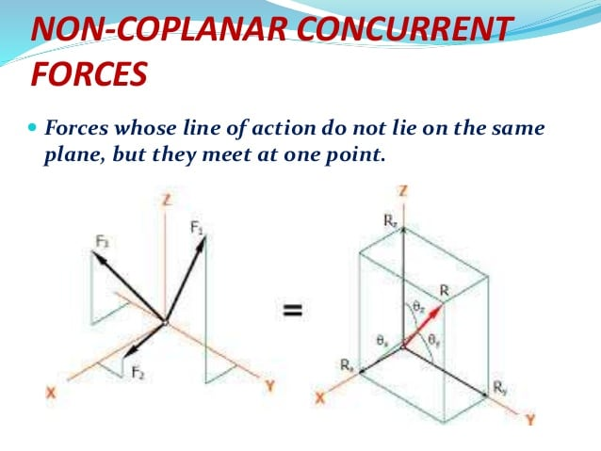
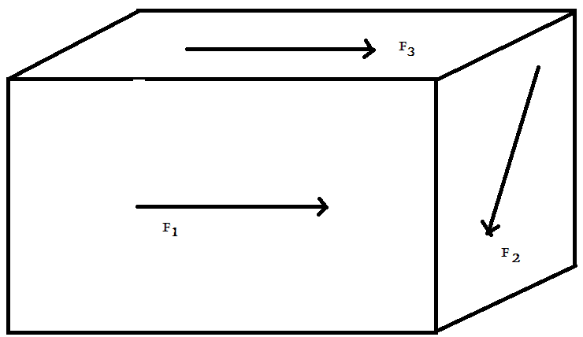
System of forces
Non-coplanar non concurrent forces

Slide 24
Scalar & Vector
Scalar
Has magnitude and no associated direction
Volume, Time, Mass, Speed, Density & Temperature.
Vector
Has magnitude and direction
Force, Moment, Velocity & Acceleration.

Slide 25
Vector classification
Fixed or bound vectors have well defined points of application that cannot be changed without affecting an analysis.
Free vectors may be freely moved in space without changing their effect on an analysis.
Sliding vectors may be applied anywhere along their line of action without affecting an analysis.

Slide 26
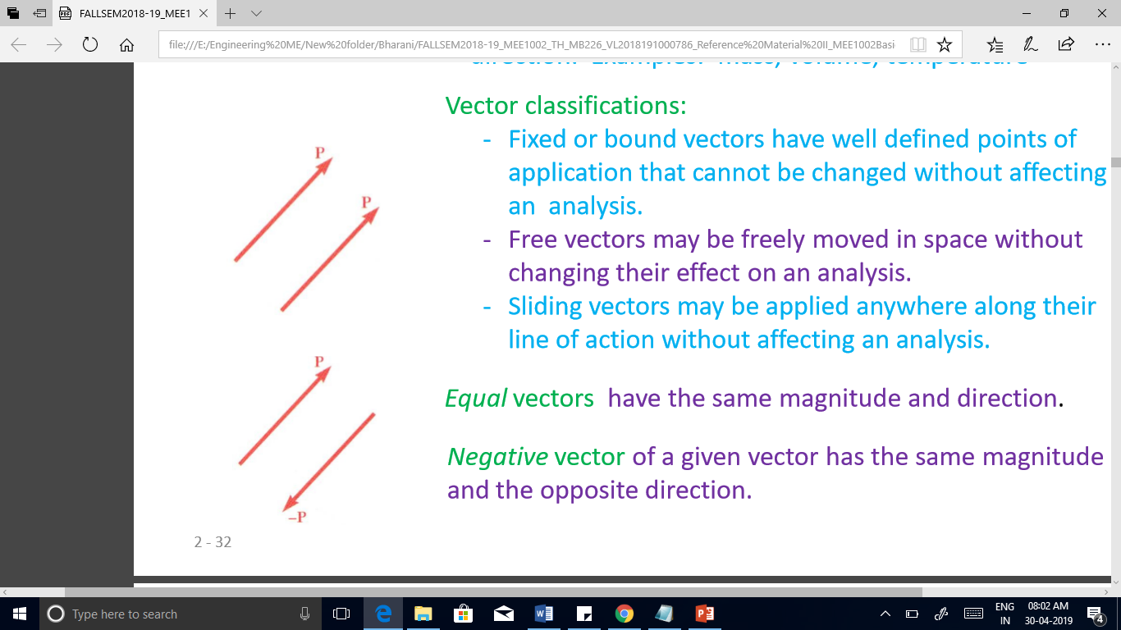
Vector classification
Equal vectors have the same magnitude and direction.
Negative vector of a given vector has the same magnitude and the opposite direction.

Slide 27
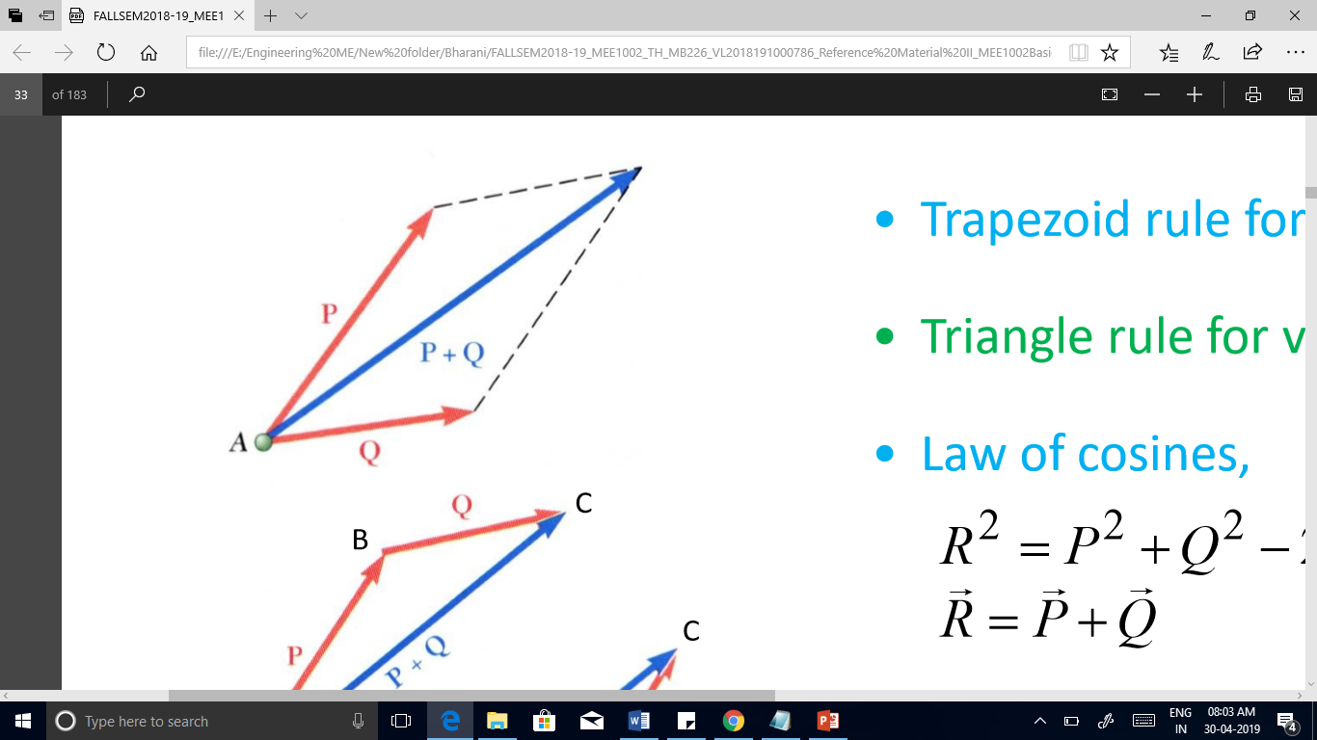
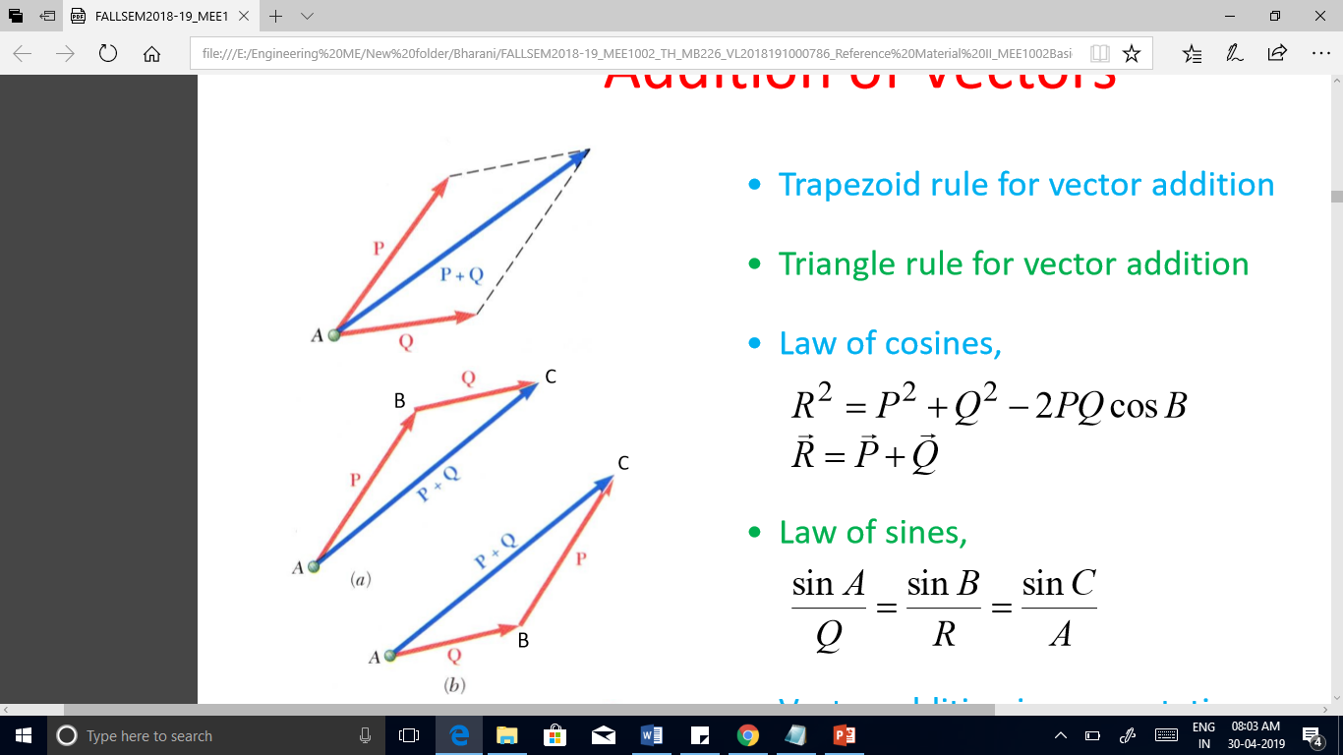
Addition of Vectors
• Parallelogram rule for vector addition
• Triangle rule for vector addition

Slide 28
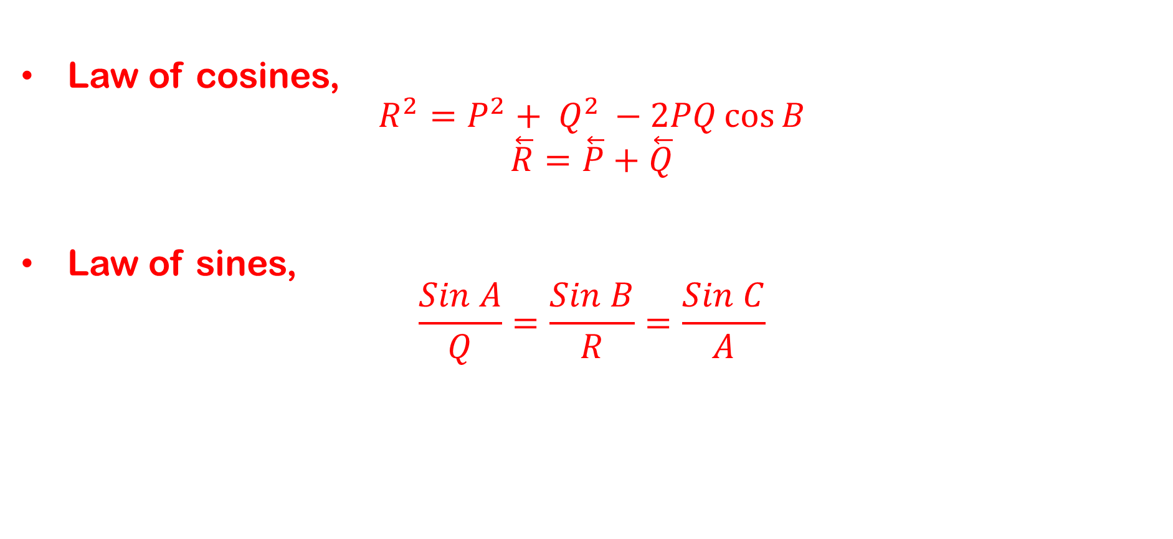
Addition of Vectors

Slide 29
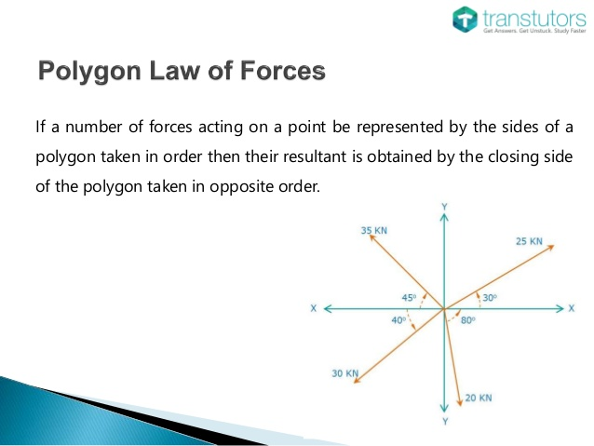
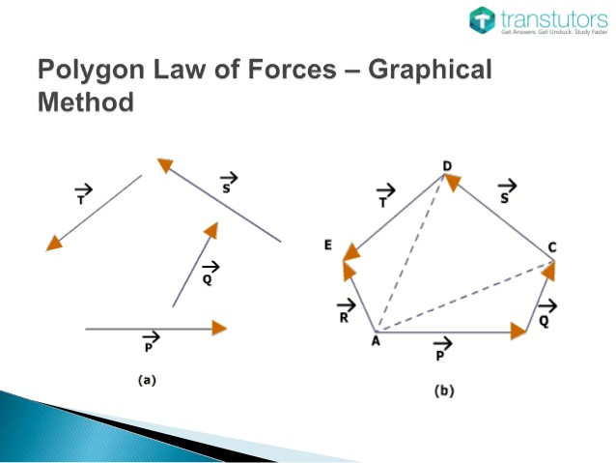
Addition of Vectors

Slide 30
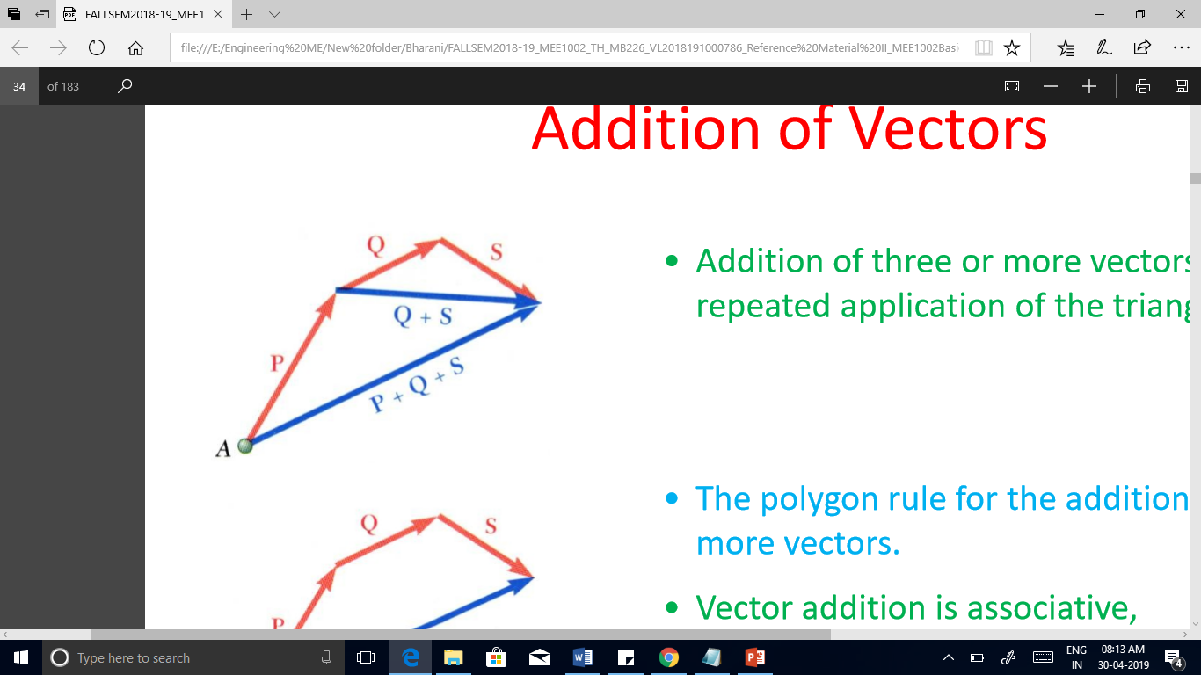
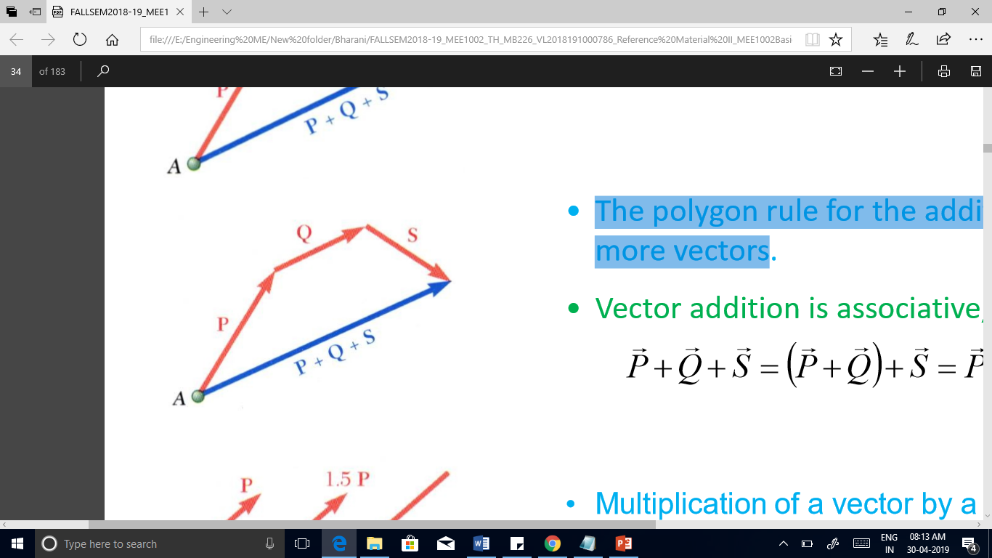
Addition of Vectors
• Addition of three or more vectors through repeated application of the triangle rule.
The polygon rule for the addition of three or more vectors.

Slide 31
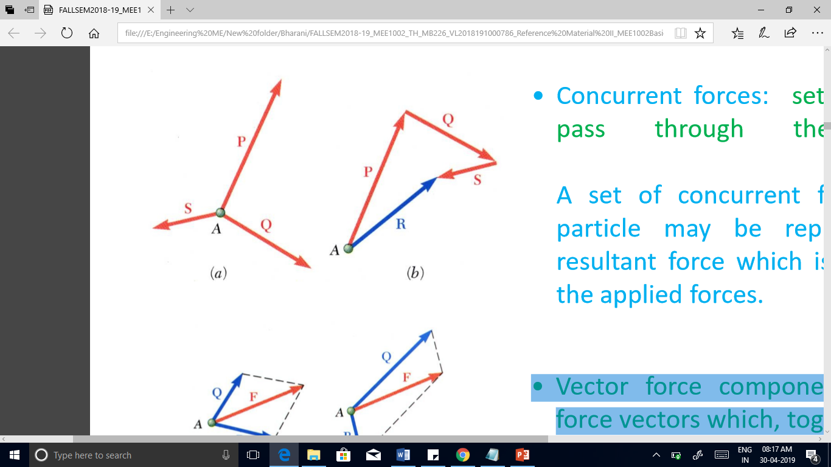
Resultant of Several Concurrent Forces
Concurrent forces: set of forces which all pass through the same point.
A set of concurrent forces applied to a particle may be replaced by a single resultant force which is the vector sum of the applied forces.

Slide 32
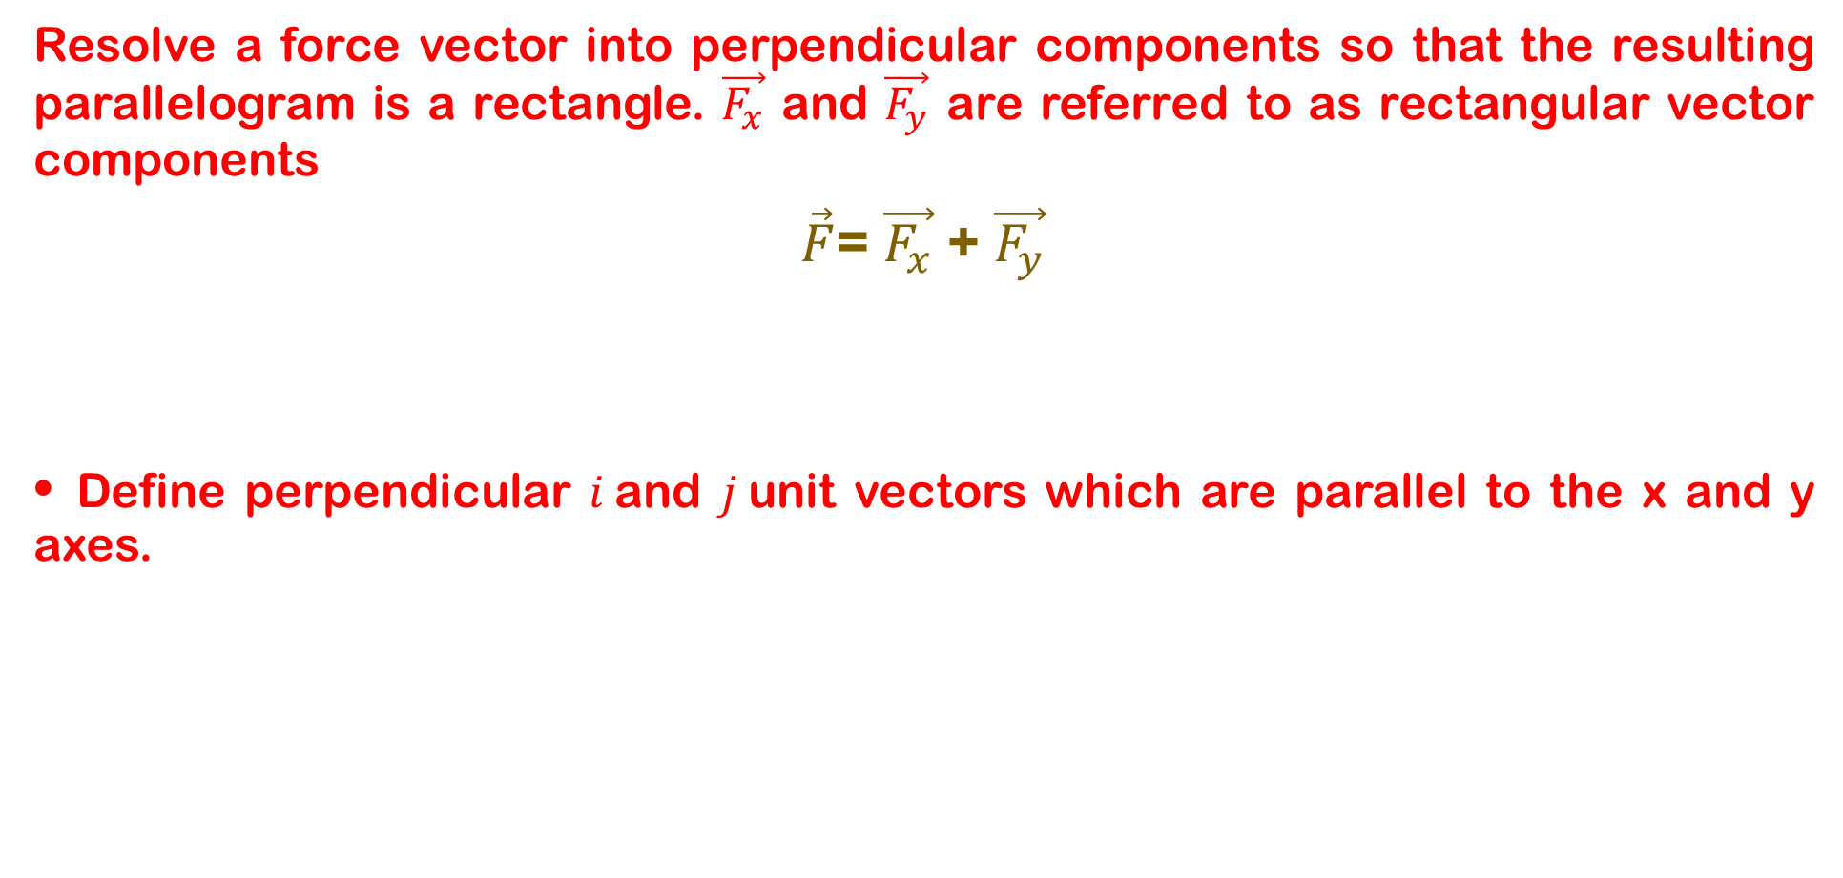
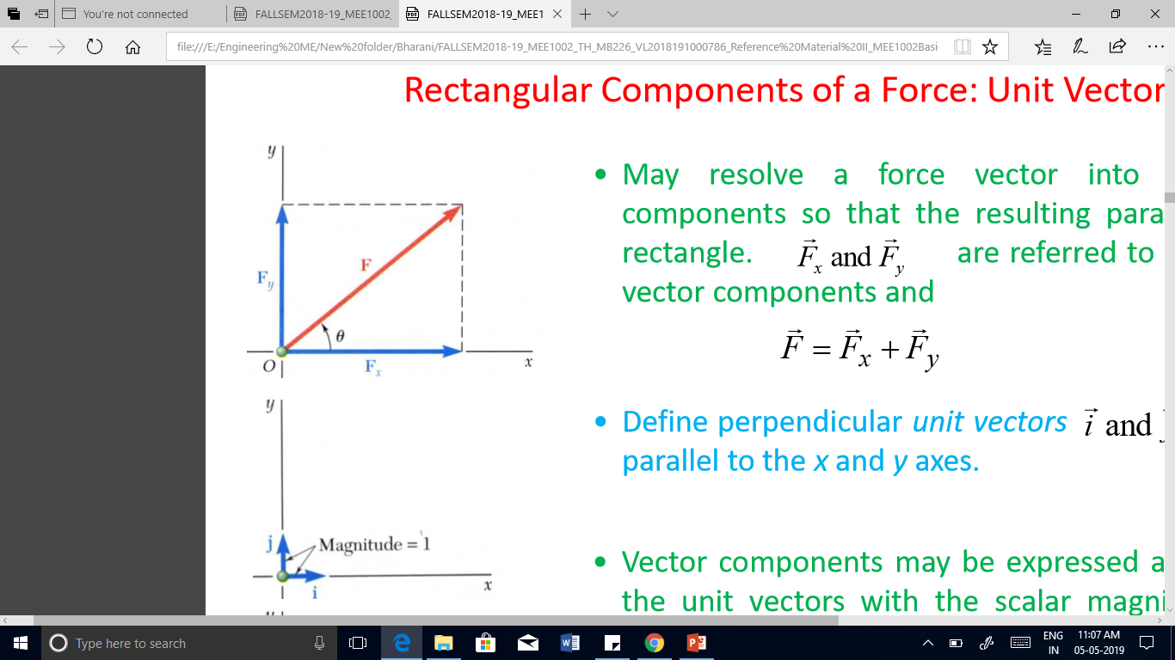
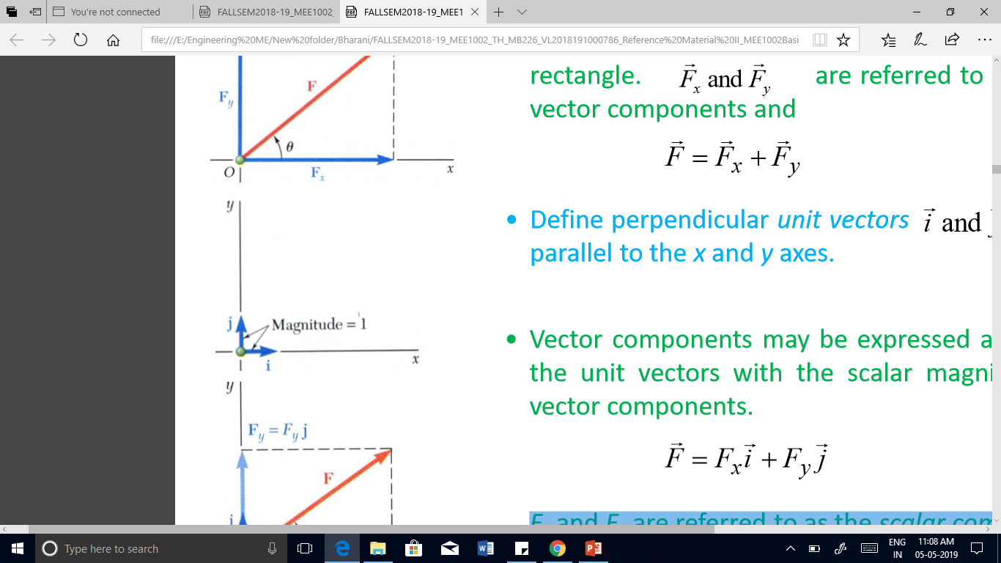
Rectangular Components of a Force: Unit Vectors

Slide 33
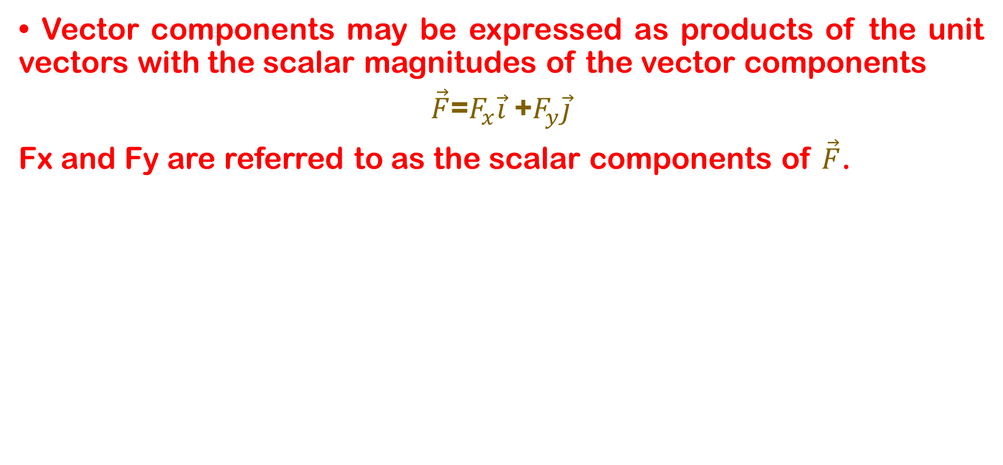
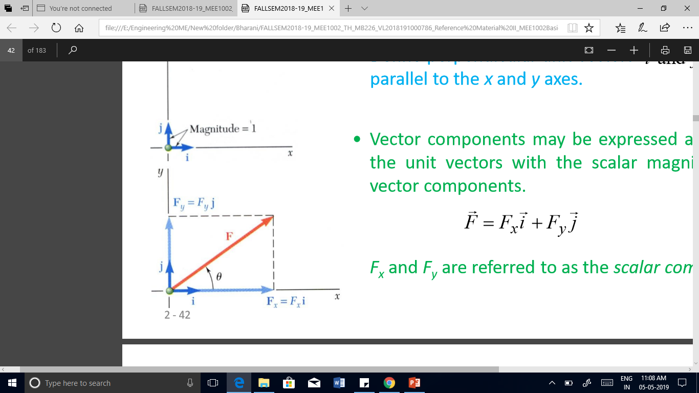
Rectangular Components of a Force: Unit Vectors

Slide 34
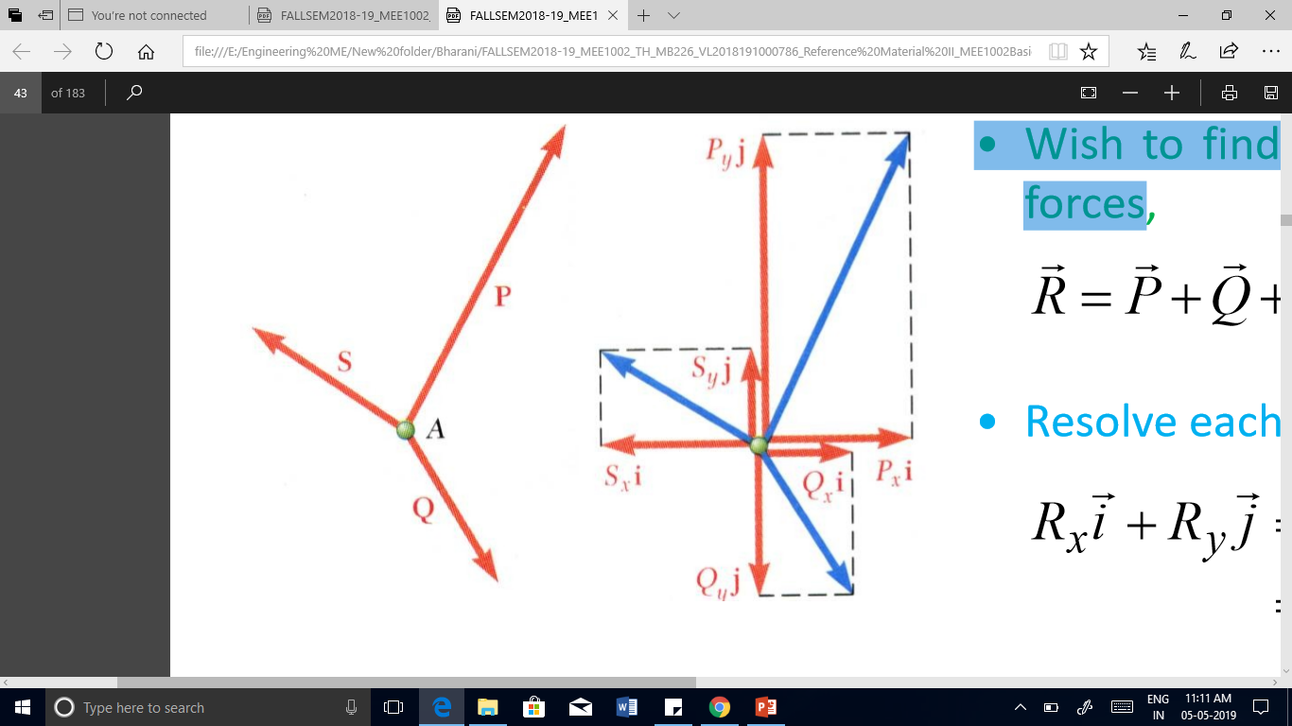
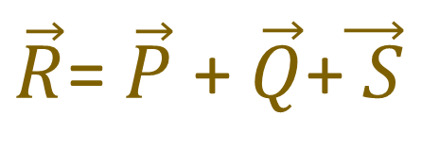
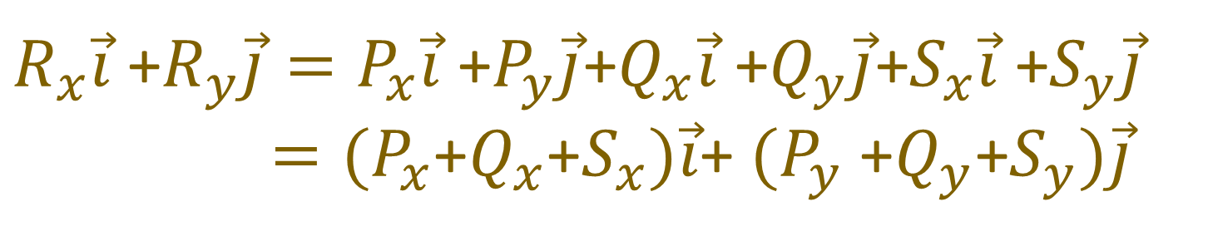
Addition of Forces by Summing Components
To find the resultant of 3 or more concurrent forces
Resolve each force into rectangular components
The scalar components of the resultant are equal to the sum of the corresponding scalar components of the given forces

Slide 35
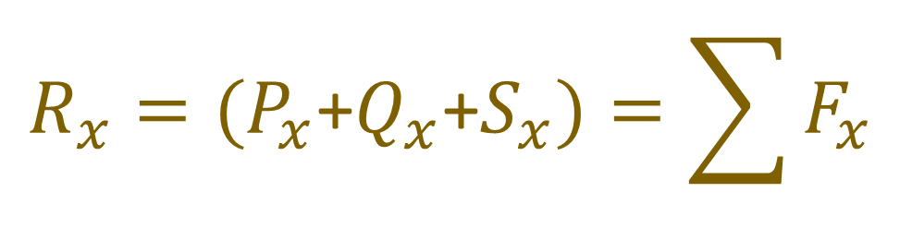
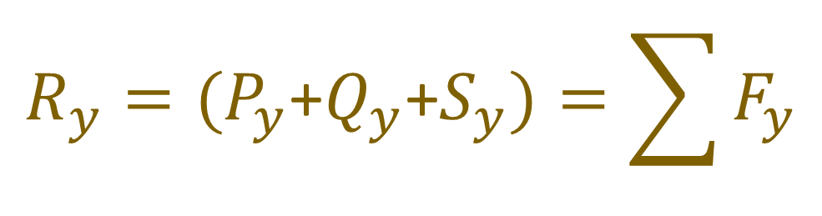
Scalar Components of resultant
The scalar components of the resultant are equal to the sum of the corresponding scalar components of the given forces.

Slide 36
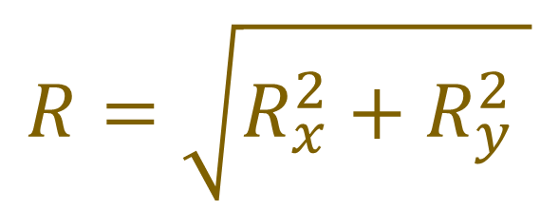
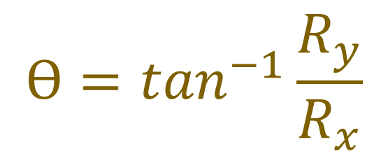
Magnitude and Direction of RESULTANT
Magnitude
Direction

Slide 37
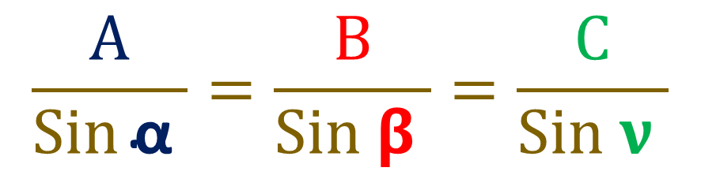
Lami’s Theorem
If the three forces acting at a point are in equilibrium, each force is proportional to the sine of the angle between the other two force
C
B
α
𝝱
ν
A
While using Lami’s theorem, all the three forces should be either directed away or all directed towards the point of concurrence

Slide 38
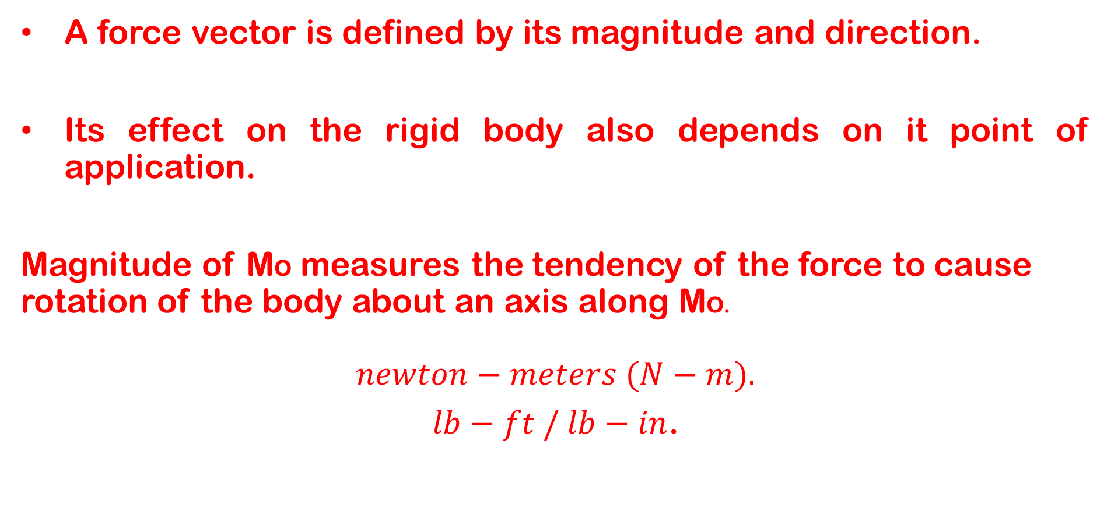
Moment of a Force About a Point

Slide 39
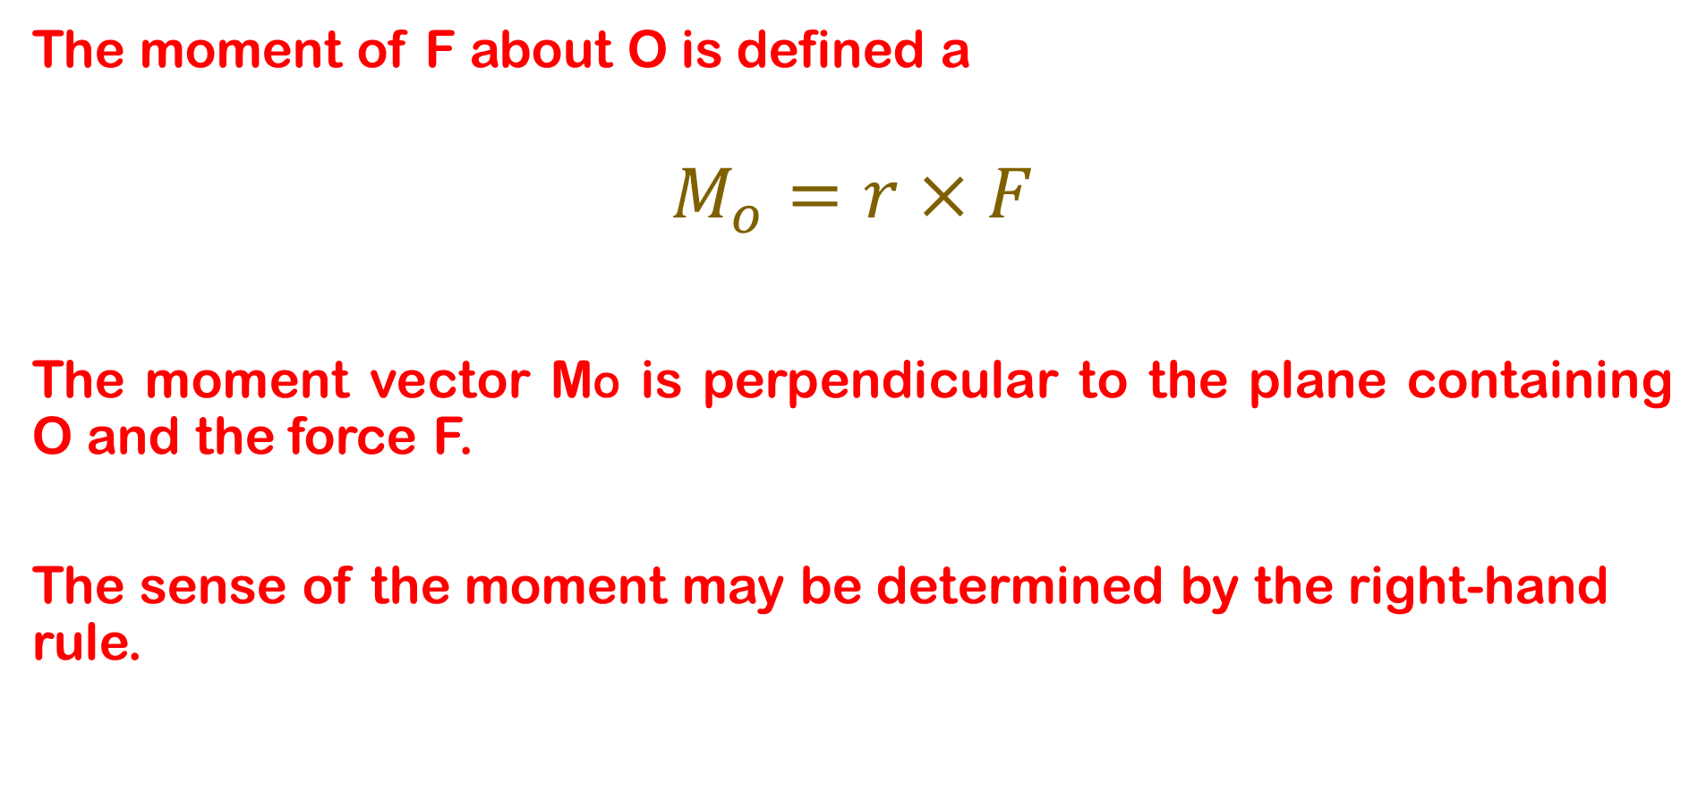
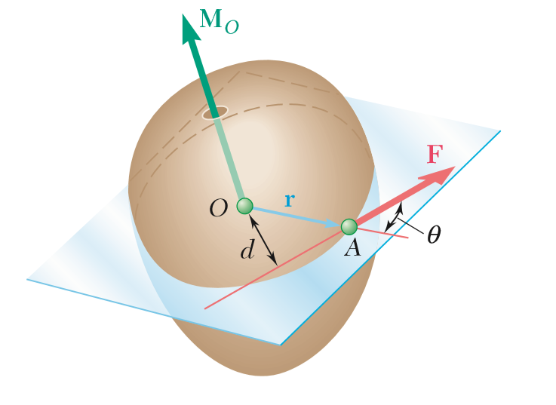
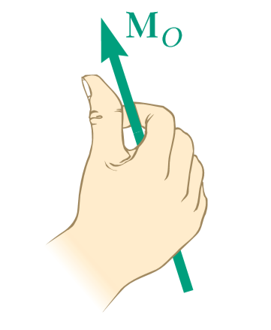
Moment

Slide 40
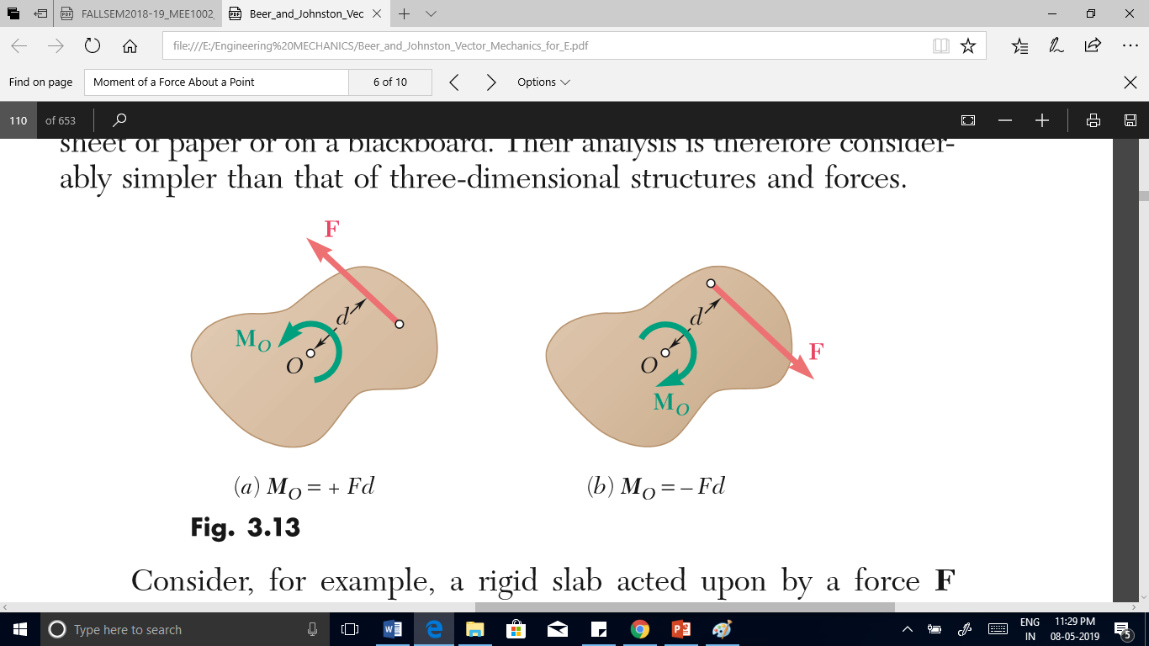
Moment in Two Dimensional System
If the force tends to rotate the structure counterclockwise, the sense of the moment vector is out of the plane of the structure and the magnitude of the moment is positive.
If the force tends to rotate the structure clockwise, the sense of the moment vector is into the plane of the structure and the magnitude of the moment is negative

Slide 41
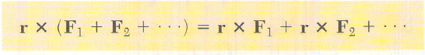
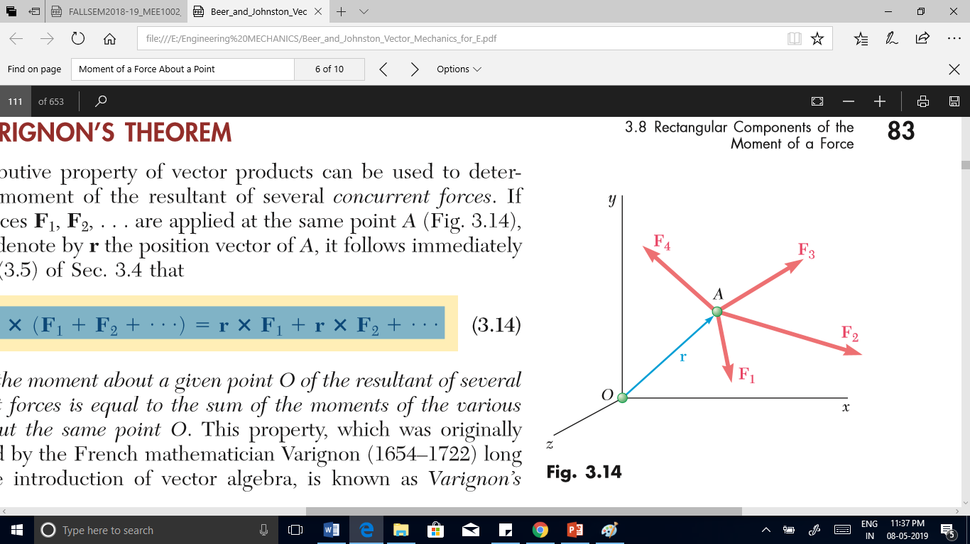
Varignon’s Theorem
The moment about a given point O of the resultant of several concurrent forces is equal to the sum of the moments of the various forces about the same point O.
French mathematician Varignon (1654–1722) long before the introduction of vector algebra, is known as Varignon’s theorem.

Slide 42
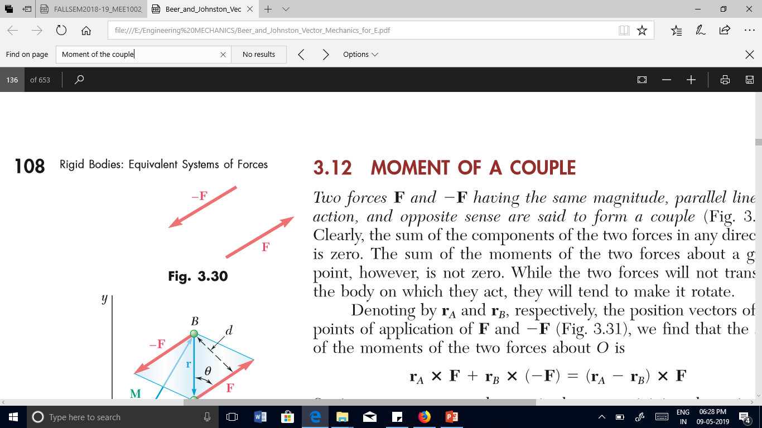
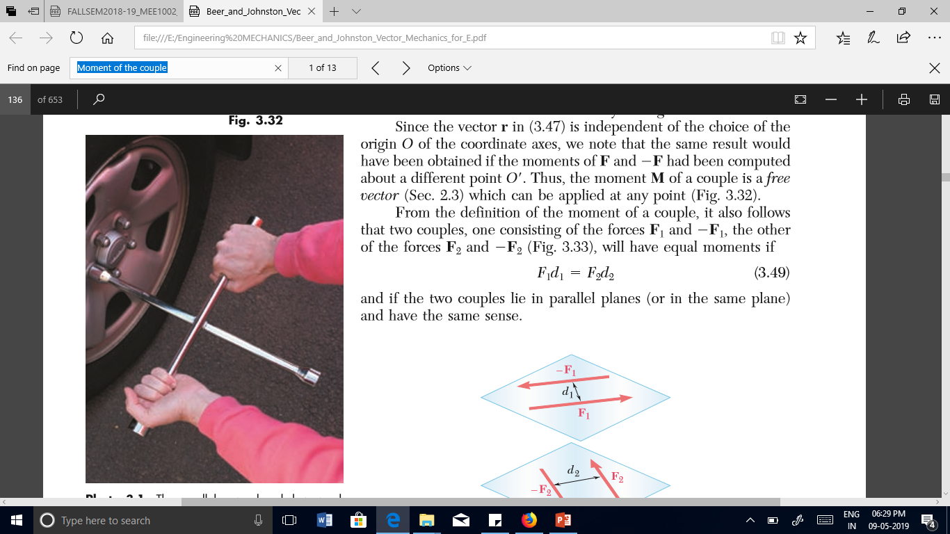
Couple
Two forces F and -F having the same magnitude, parallel lines of action, and opposite sense are said to form a couple.
The sum of the components of the two forces in any direction is zero.
The sum of the moments of the two forces about a given point, however, is not zero.

Slide 43
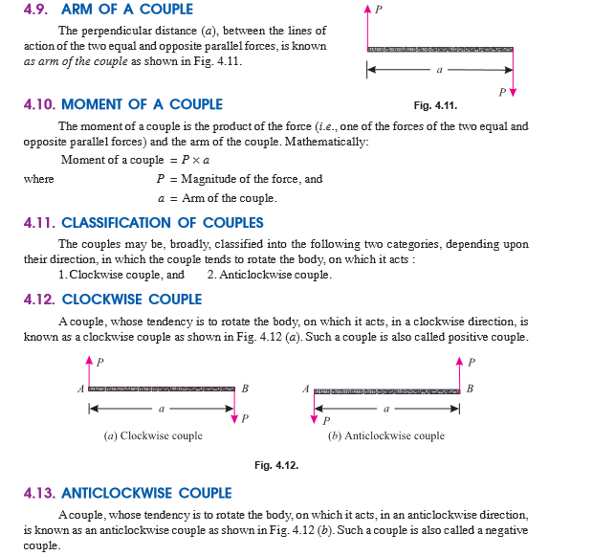

Slide 44
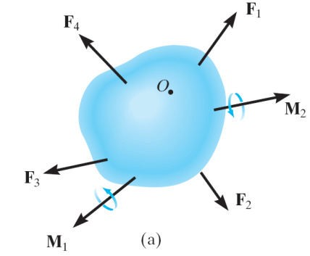
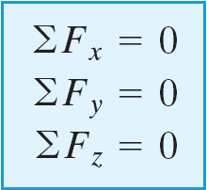
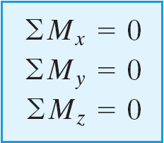
Rigid Body Equilibrium
A rigid body will remain in equilibrium provided
Sum of all the external forces acting on the body is equal to zero, and
Sum of the moments of the external forces about a point is equal to zero
y
z
x

Slide 45
TUTORIAL 1

